Slide 1
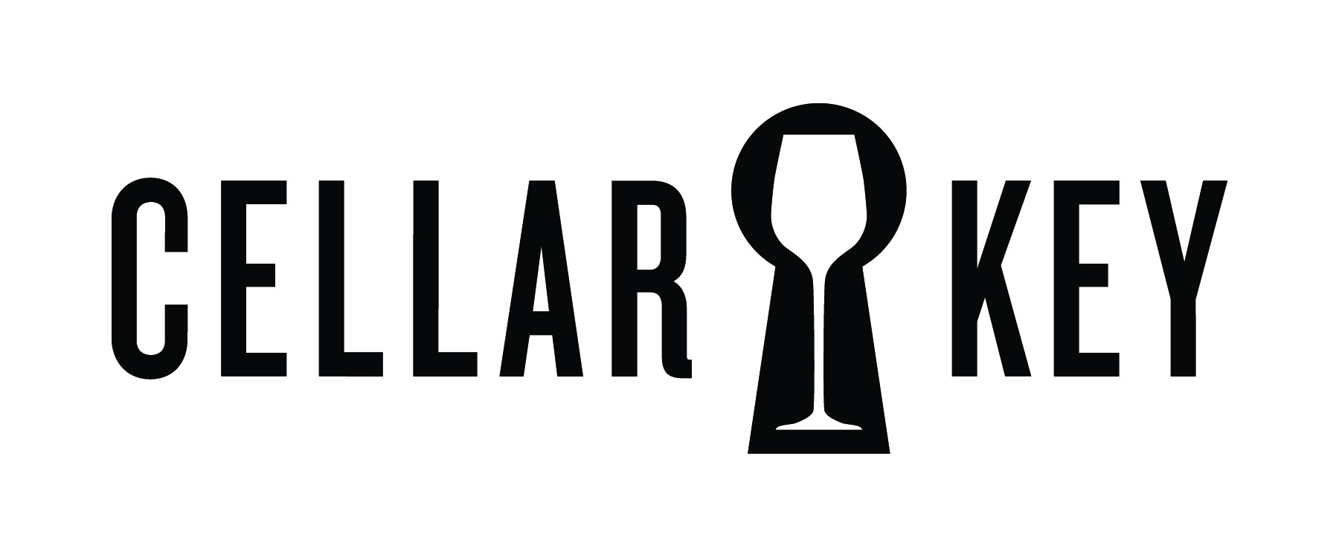
2010 Nuthouse Pinot Noir
Willamette Valley, OR
2010 Nuthouse Pinot Noir
Willamette Valley, OR
"A taut, vibrant style, packing plenty
of raspberry, tobacco, tea and spice flavors into a lean, focused beam, persisting into the extended finish. Best from 2014
through 2020.” –HS
"A taut, vibrant style, packing plenty
of raspberry, tobacco, tea and spice flavors into a lean, focused beam, persisting into the extended finish. Best from 2014
through 2020.” –HS
92
92
points
points
Scan and explore.
Visit getcellarkey.com on your smartphone
Scan and explore.
Visit getcellarkey.com on your smartphone
argylewinery.com
argylewinery.com
2010 Nuthouse Pinot Noir
Willamette Valley, OR
2010 Nuthouse Pinot Noir
Willamette Valley, OR
"A taut, vibrant style, packing plenty
of raspberry, tobacco, tea and spice flavors into a lean, focused beam, persisting into the extended finish. Best from 2014
through 2020.” –HS
"A taut, vibrant style, packing plenty
of raspberry, tobacco, tea and spice flavors into a lean, focused beam, persisting into the extended finish. Best from 2014
through 2020.” –HS
92
92
points
points
Scan and explore.
Visit getcellarkey.com on your smartphone
Scan and explore.
Visit getcellarkey.com on your smartphone
argylewinery.com
argylewinery.com

